Slide 1



Slide 2



Slide 3
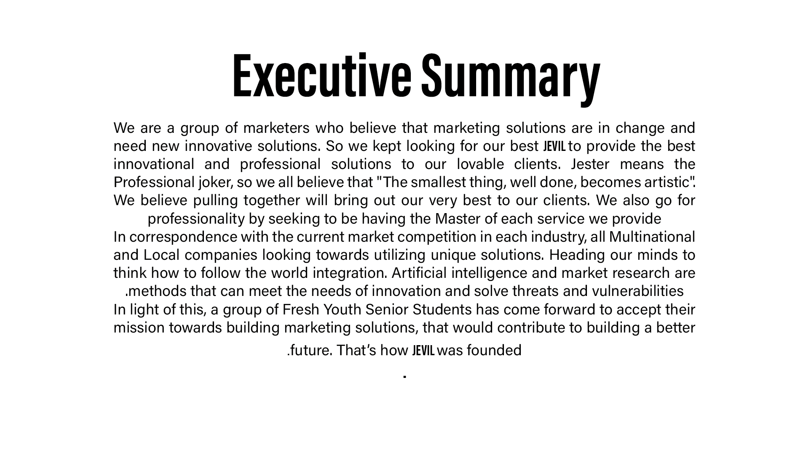

Slide 4
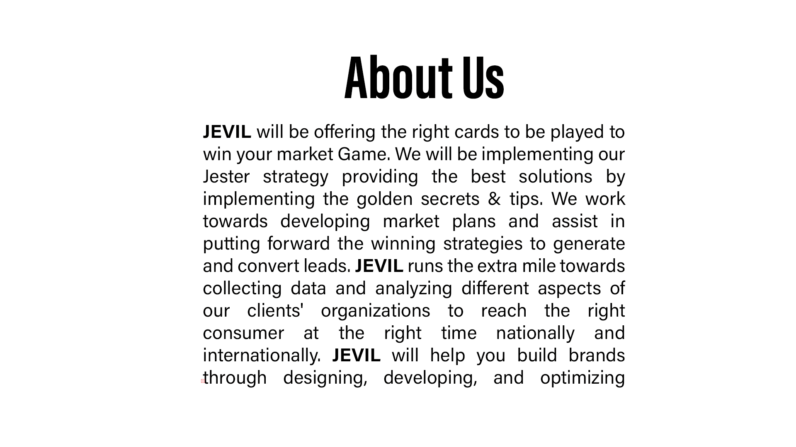

Slide 5
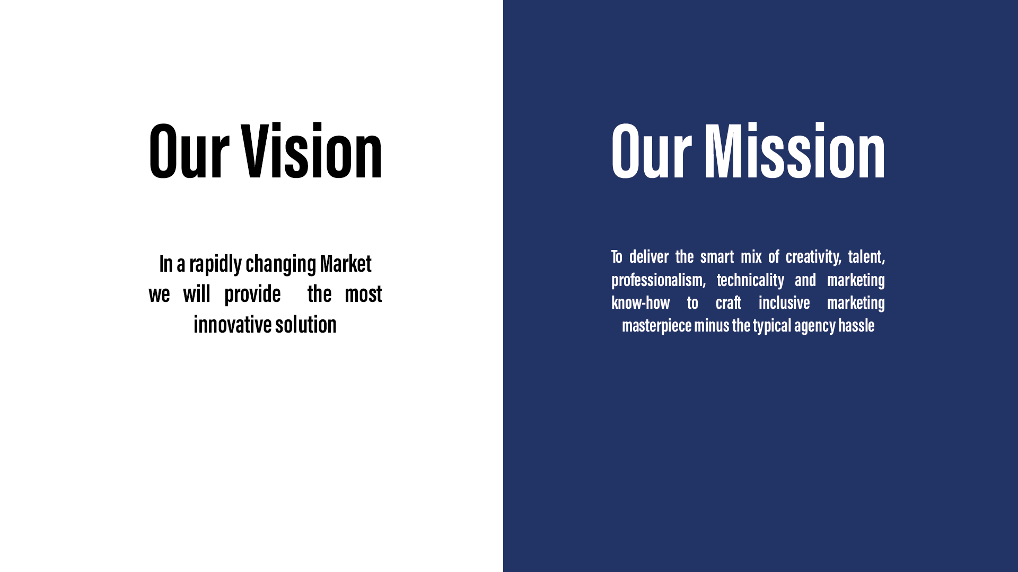

Slide 6
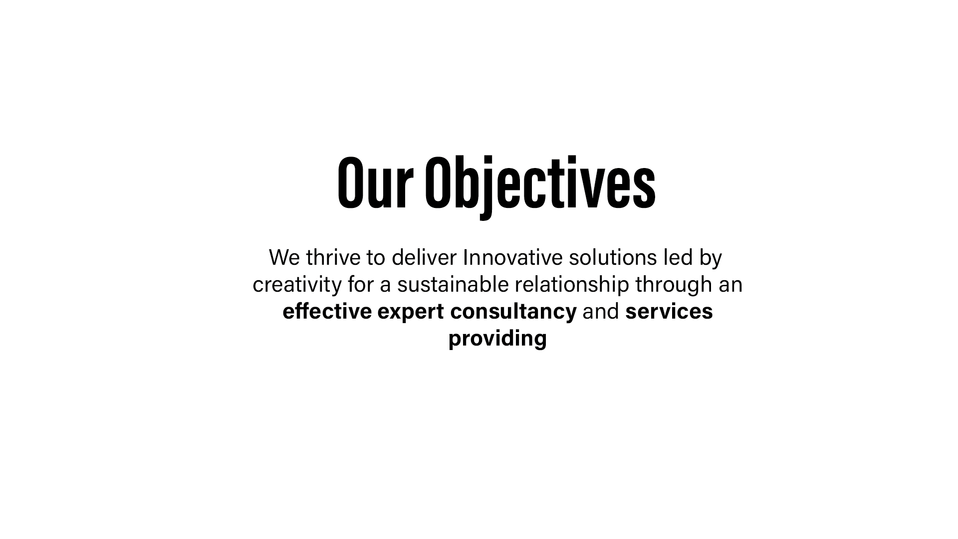

Slide 7
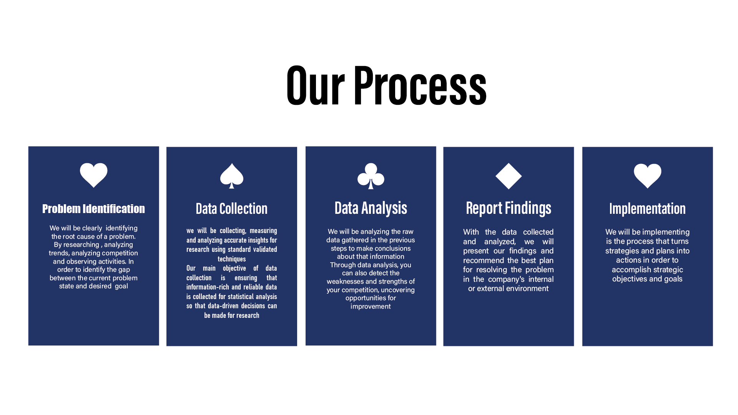

Slide 8
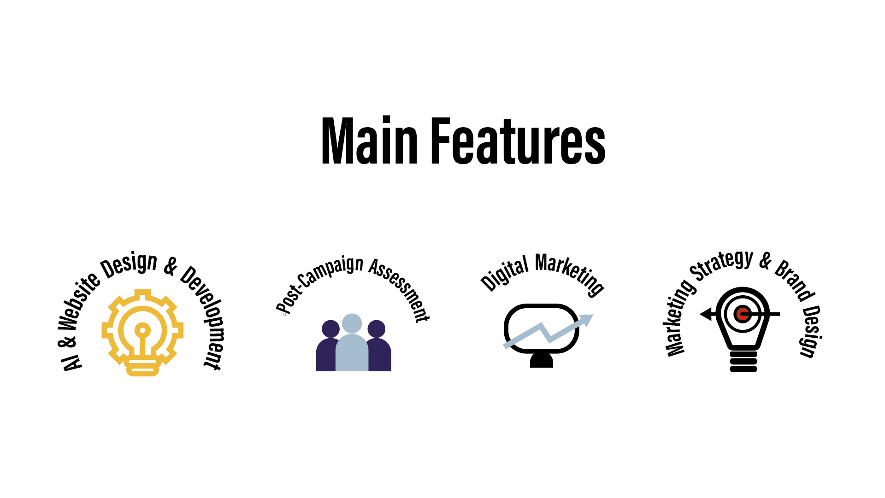

Slide 9
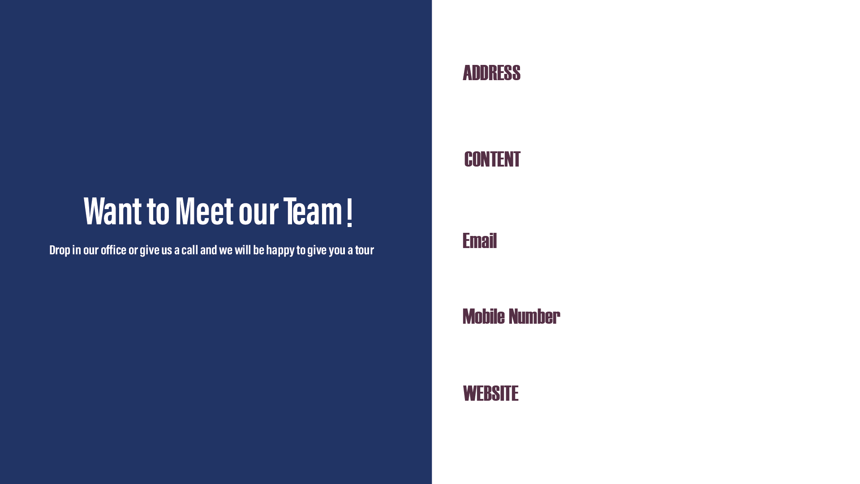
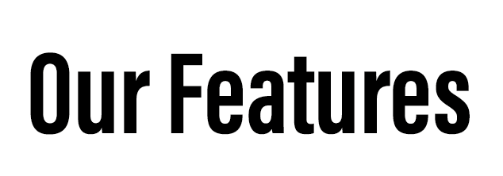
Cu
B
Customized Digital Marketing Planning
Social Media Monitoring
Website Development
Market Research
Marketing Analytics
& Reporting
Premium Content Offering
AI Solutions
B
Youtube
Ads
Digital Expert Support
Account Management
Digital
Insights
Concept Creation and Development
Workflow Campaign
Situation Analysis
B
B
B
Buyer Personas
Post Campaign Analysis
CRM Integration
Email Marketing
SMS
Advertising
Google Ads Management
& Display Ads
Video Production

Slide 10
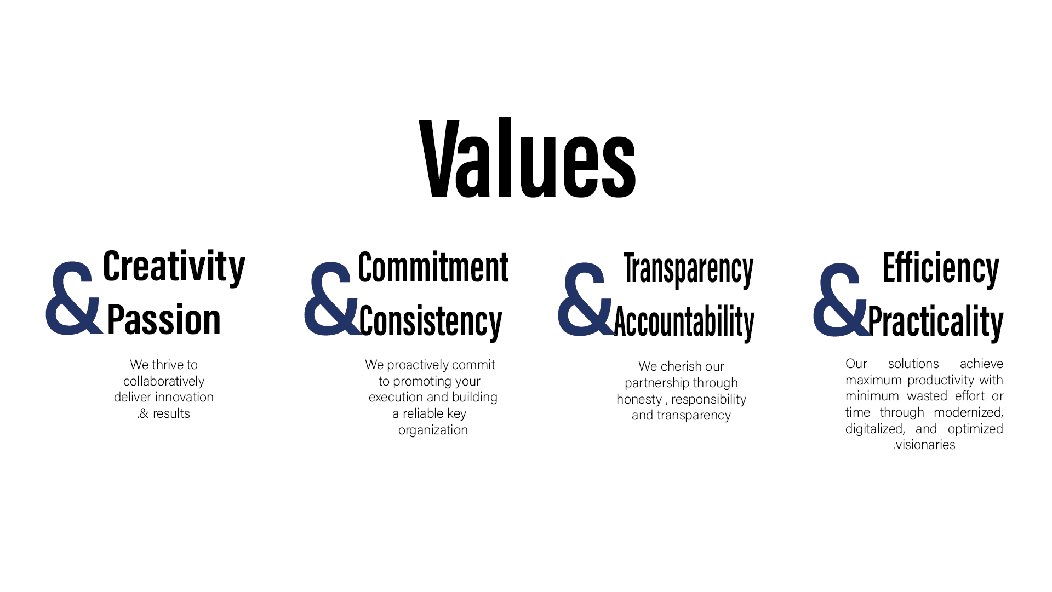

Slide 11





Slide 12
2-B police apartment Kornish El Maadi
Main Features
Mohamed.Waheed.gm@gmail.com
01226338944

